Slide 1
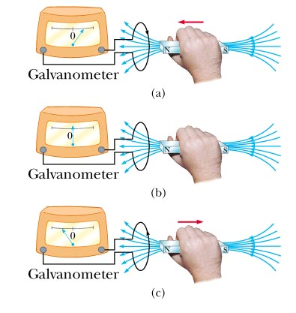
Electromagnetic Induction

Slide 2
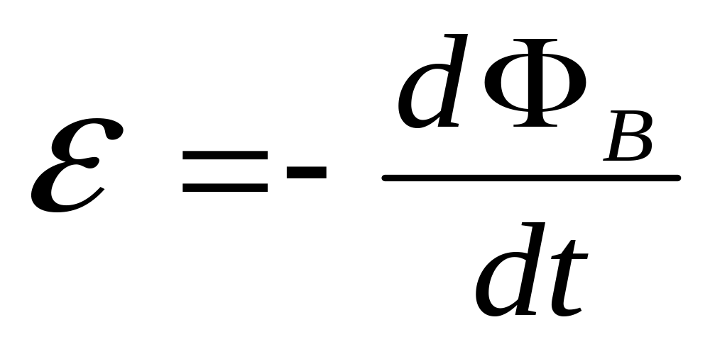
Faraday’s Law of Induction
A changing magnetic flux induces an EMF

Slide 3
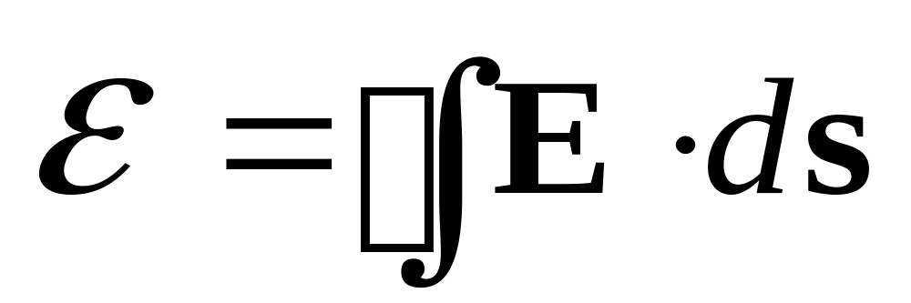
What is EMF?
Looks like potential. It’s a “driving force” for current

Slide 4
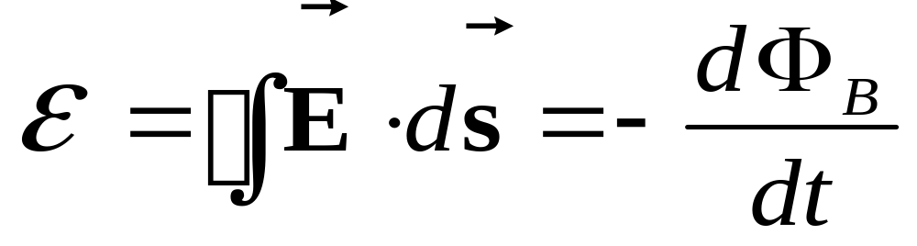
Faraday’s Law of Induction
A changing magnetic flux induces an EMF, a curling E field

Slide 5
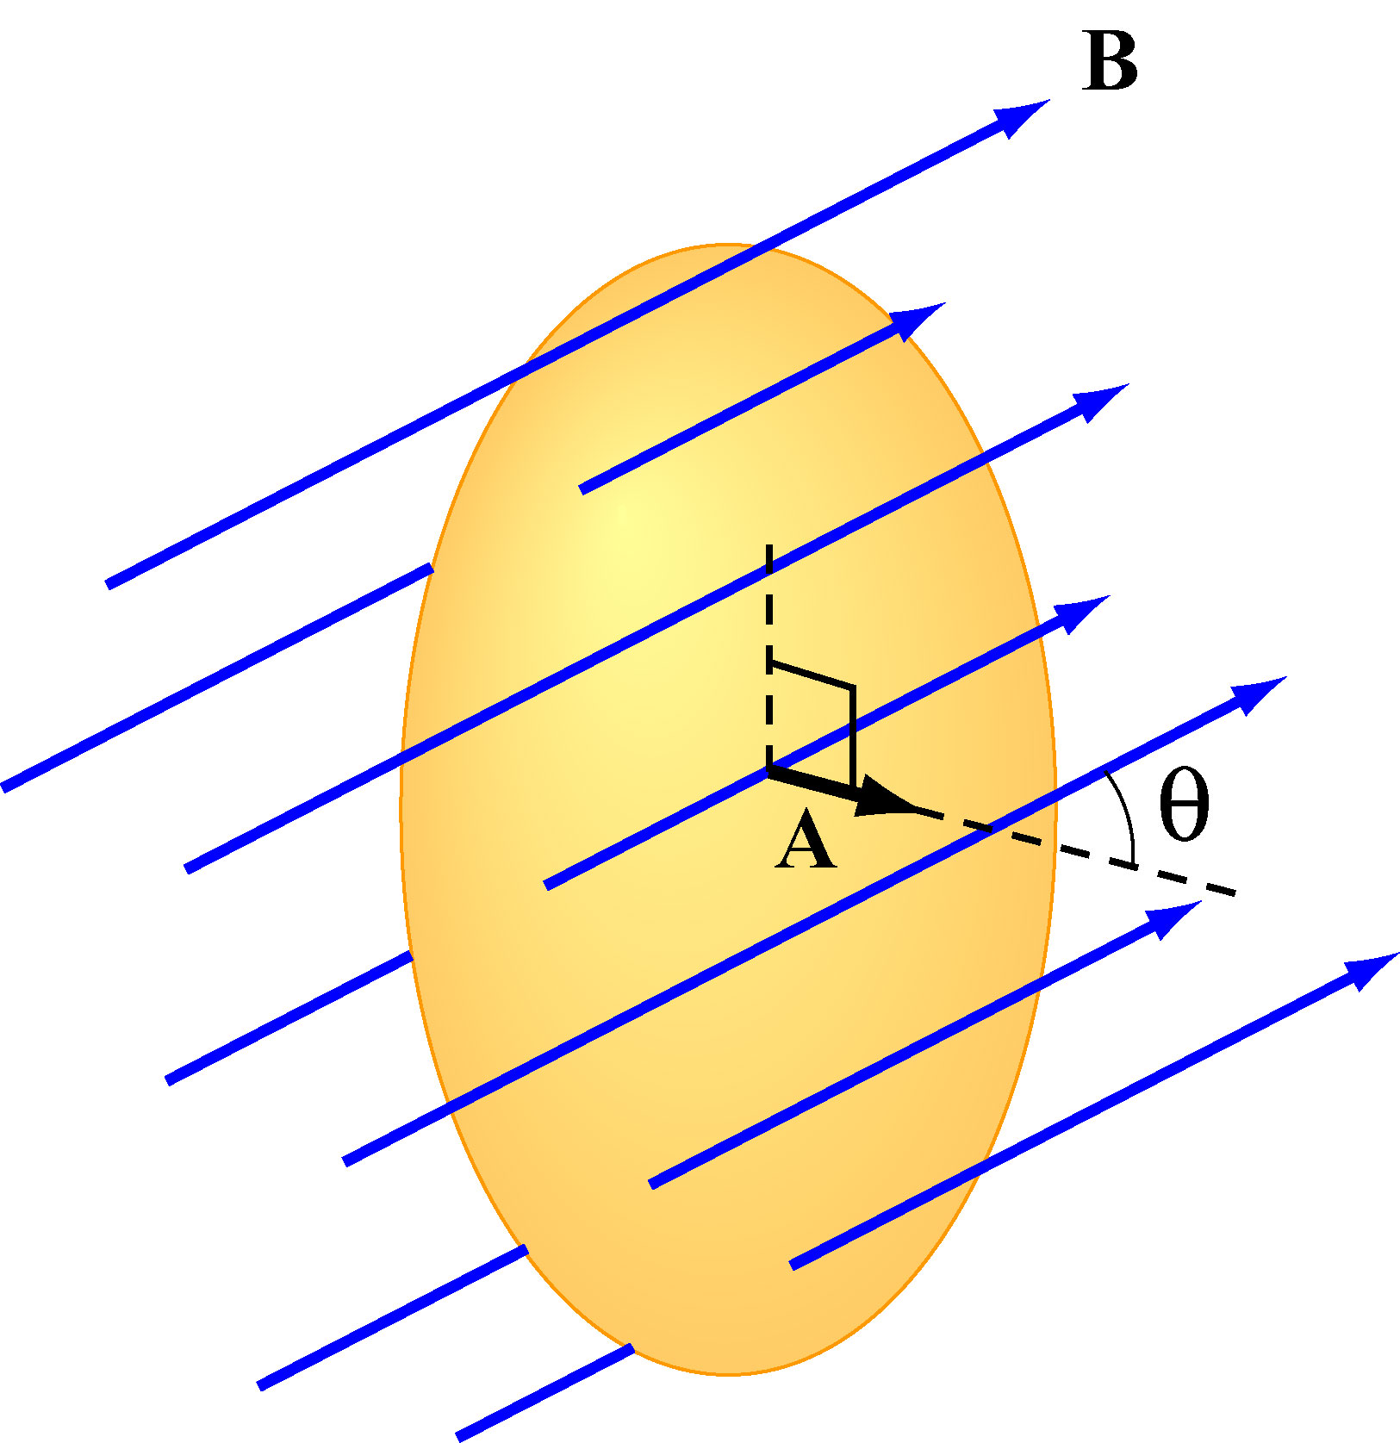
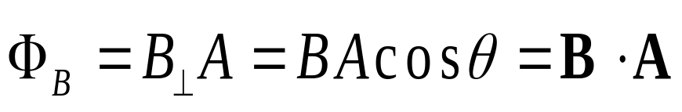
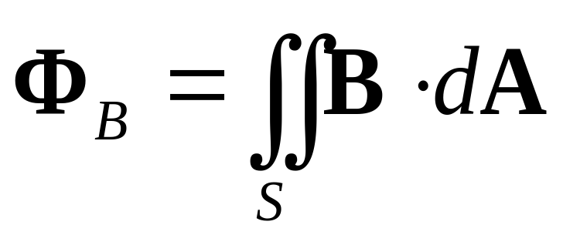
Magnetic Flux Thru Wire Loop
Analogous to Electric Flux (Gauss’ Law)
(1) Uniform B
(2) Non-Uniform B

Slide 6
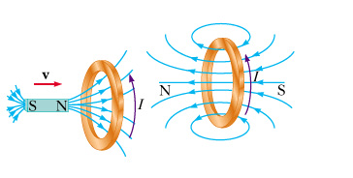
Minus Sign? Lenz’s Law
Induced EMF is in direction that opposes the change in flux that caused it

Slide 7

Faraday’s Law of Induction
Changing magnetic flux induces an EMF
Lenz: Induction opposes change
Notes:
Week 9, Day 2
Class 21

Slide 8
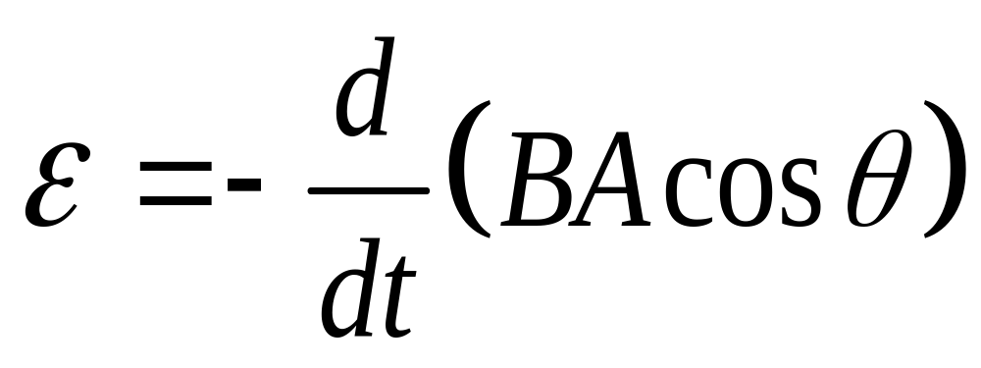
Ways to Induce EMF
Quantities which can vary with time:
Magnitude of B
Area A enclosed by the loop
Angle θ between B and loop normal

Slide 9
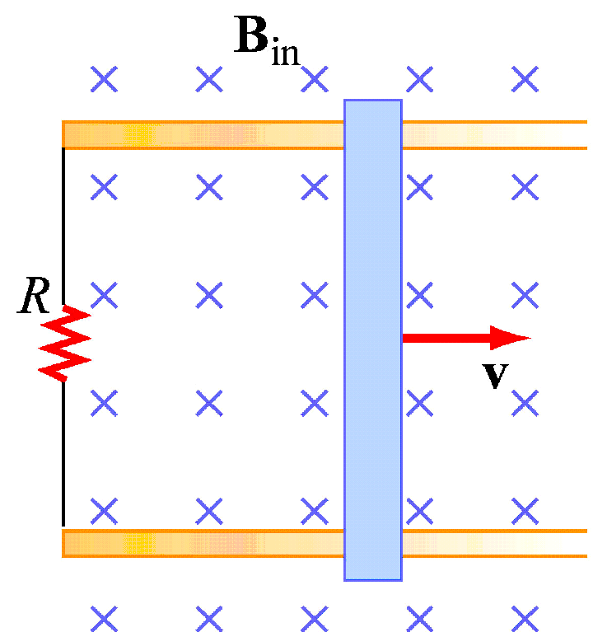

Conducting rod pulled along two conducting rails in a uniform magnetic field B at constant velocity v
Direction of induced current?
Direction of resultant force?
Magnitude of EMF?
Magnitude of current?
Power externally supplied to move at constant v?

Slide 10
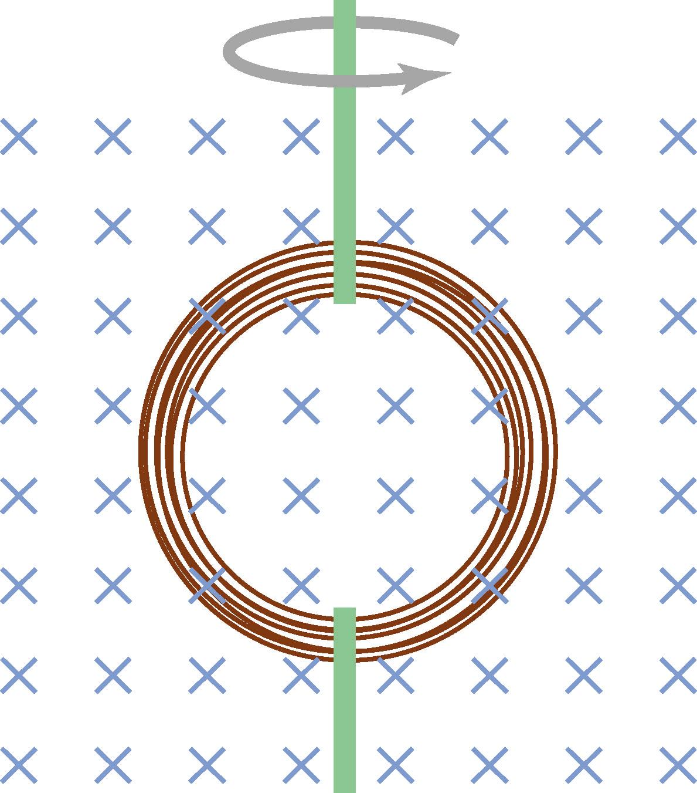
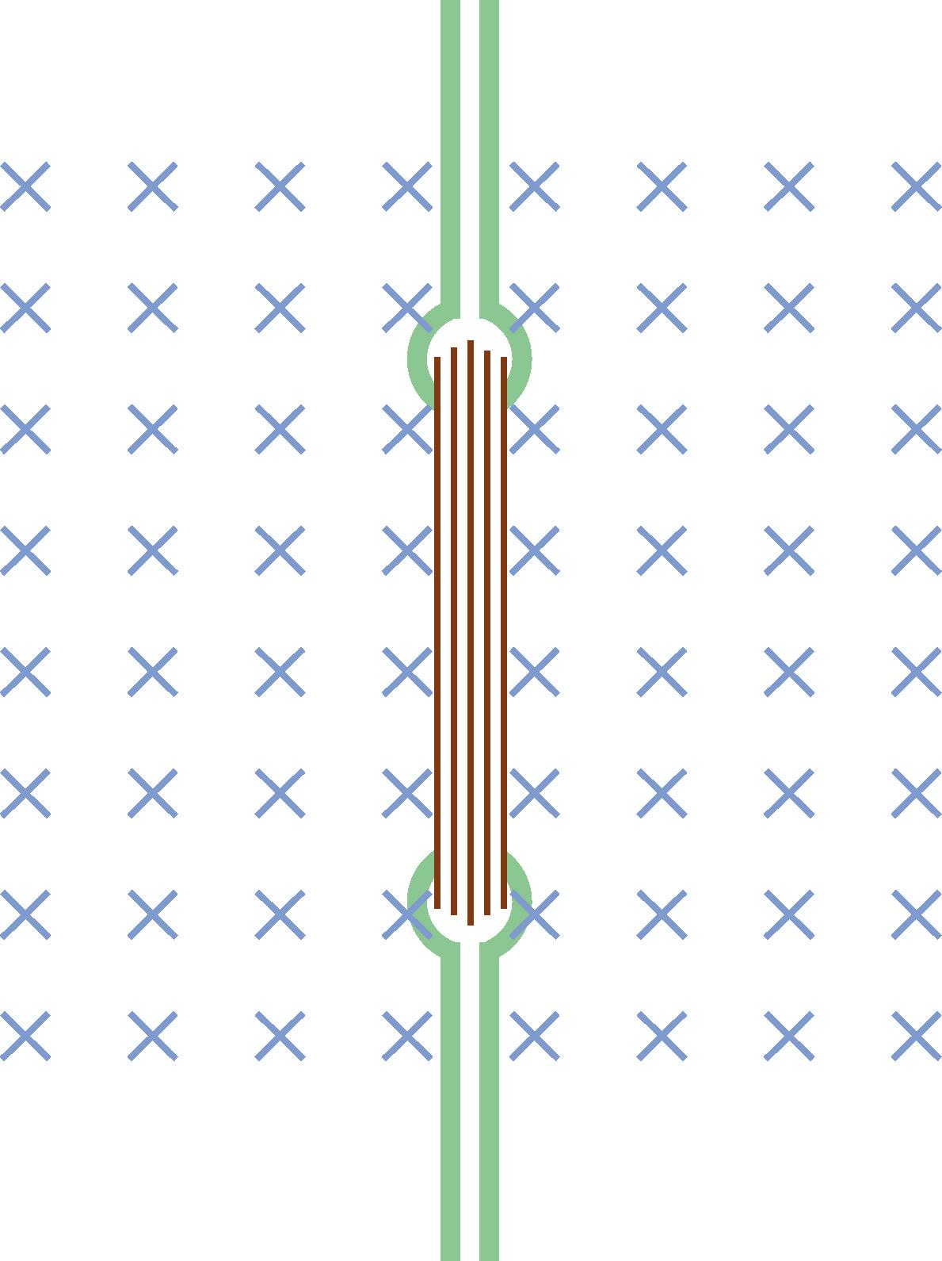
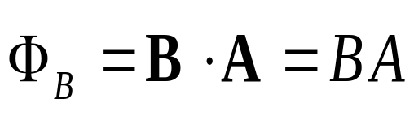
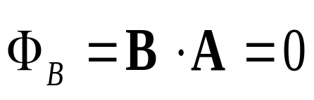
Changing Angle

Slide 11
Faraday’s Law of Induction
Changing magnetic flux induces an EMF
Lenz: Induction opposes change
Notes:
Week 9, Day 3
Class 22

Slide 12
First:
Mutual Inductance
Notes:
Week 9, Day 3
Class 22

Slide 13
Demonstration:
Remote Speaker
Notes:
Week 9, Day 3
Class 22

Slide 14
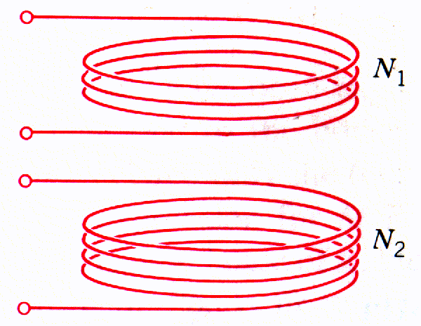
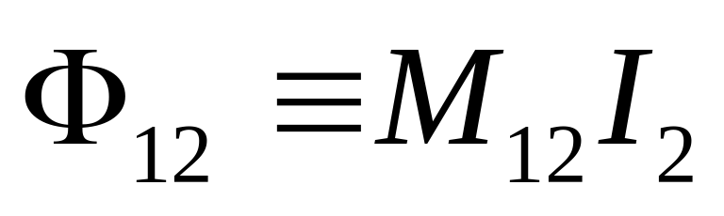
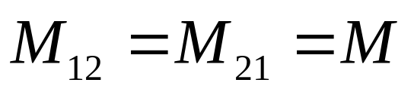
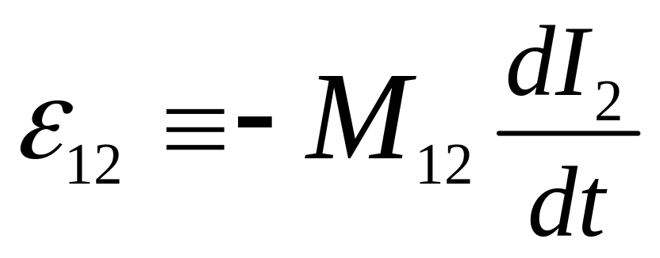
Mutual Inductance
Current I₂ in coil 2, induces magnetic flux Φ₁₂ in coil 1.
“Mutual inductance” M₁₂:
Change current in coil 2?
Induce EMF in coil 1:
Notes:
Week 9, Day 3
Class 22

Slide 15
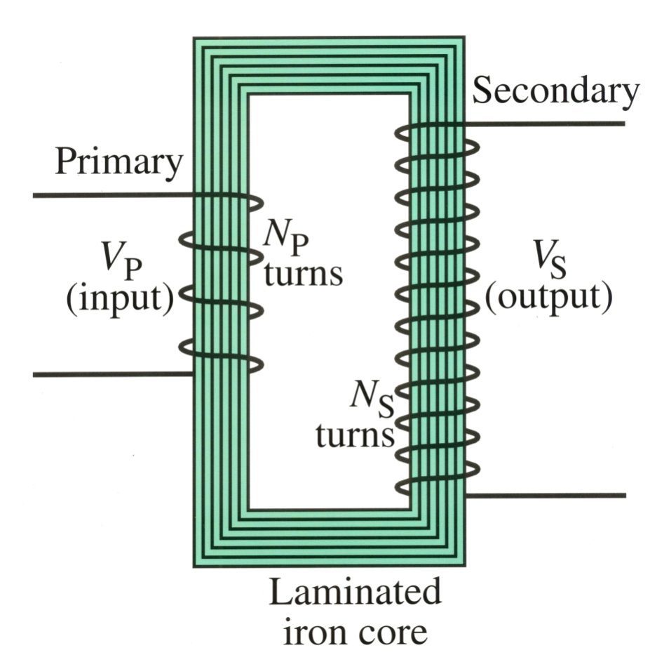
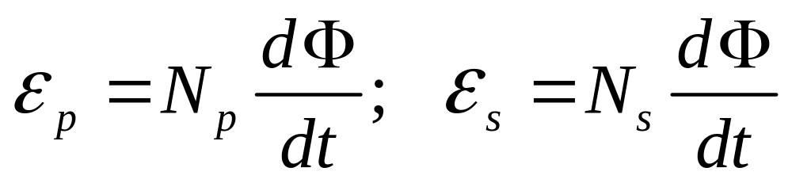
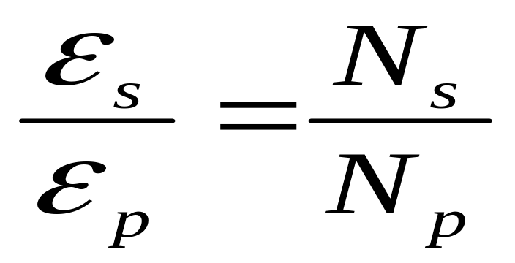
Transformer
Step-up transformer
Flux Φ through each turn same:
N_{s} > N_{p}: step-up transformer
N_{s} < N_{p}: step-down transformer
Notes:
Week 9, Day 3
Class 22

Slide 16
Demonstrations:
One Turn Secondary:
Nail
Many Turn Secondary:
Jacob’s Ladder
Notes:
Week 9, Day 3
Class 22

Slide 17
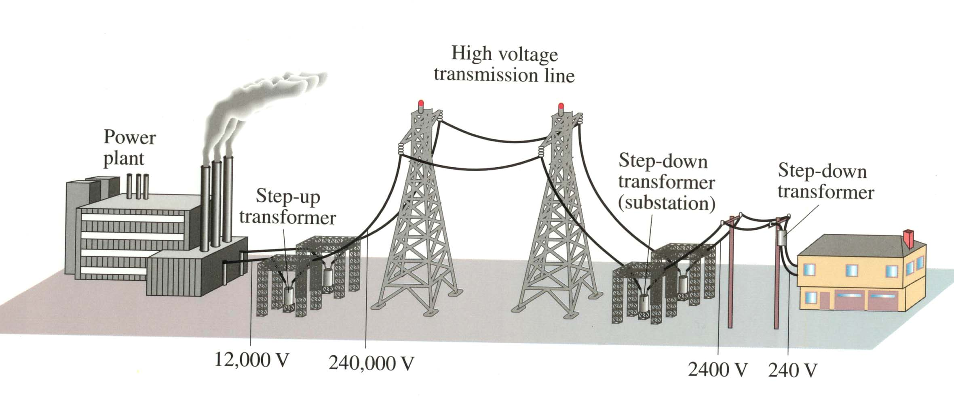
Transmission of Electric Power
Power loss can be greatly reduced if transmitted at high voltage
Notes:
Week 9, Day 3
Class 22

Slide 18
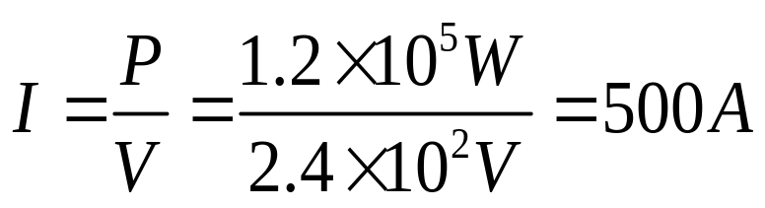
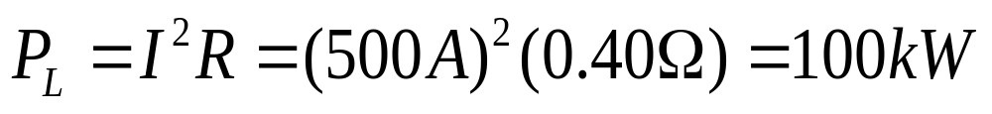
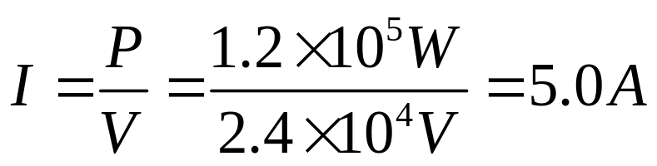
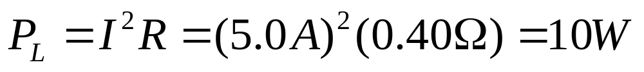
Example: Transmission lines
An average of 120 kW of electric power is sent from a power plant. The transmission lines have a total resistance of 0.40 Ω. Calculate the power loss if the power is sent at (a) 240 V, and (b) 24,000 V.
(a)
83% loss!!
(b)
0.0083% loss
Notes:
Week 9, Day 3
Class 22

Slide 19
Group Discussion: Transmission lines
We just calculated that I²R is smaller
for bigger voltages.
What about V²/R? Isn’t that bigger?
Why doesn’t that matter?
Notes:
Week 9, Day 3
Class 22

Slide 20
Self Inductance
Notes:
Week 9, Day 3
Class 22

Slide 21
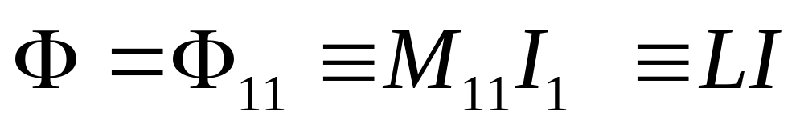
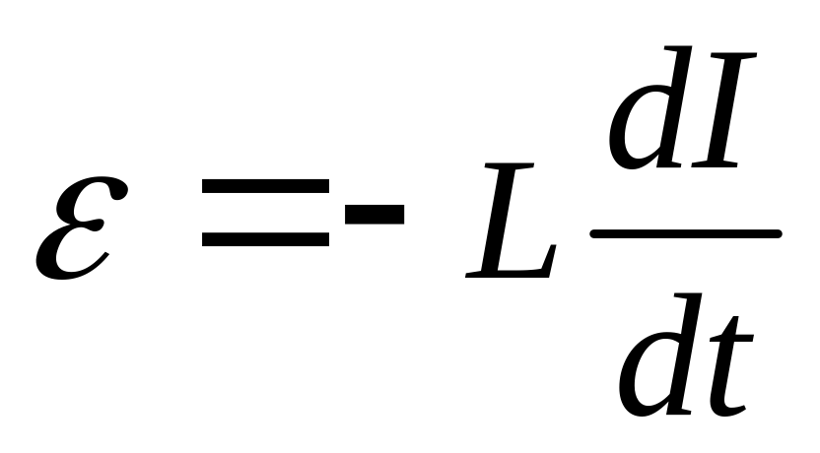
Self Inductance
What if we forget about coil 2 and ask about putting current into coil 1?
There is “self flux”:
Faraday’s Law →
Notes:
Week 9, Day 3
Class 22

Slide 22
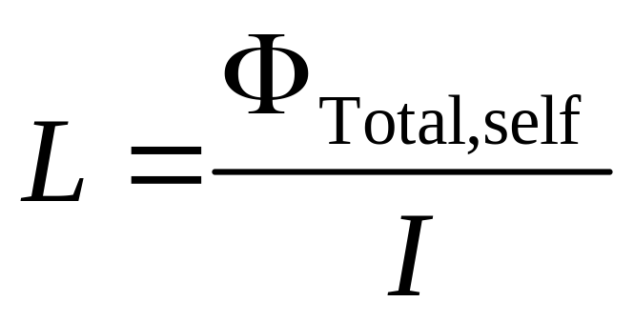
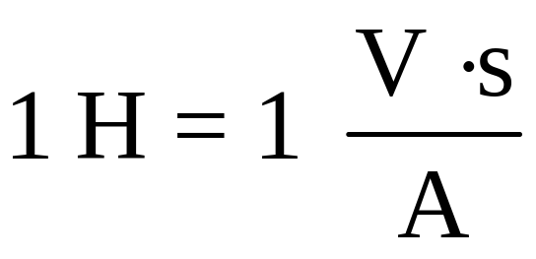
Calculating Self Inductance
Unit: Henry
Assume a current I is flowing in your device
Calculate the B field due to that I
Calculate the flux due to that B field
Calculate the self inductance (divide out I)
Notes:
Week 9, Day 3
Class 22

Slide 23
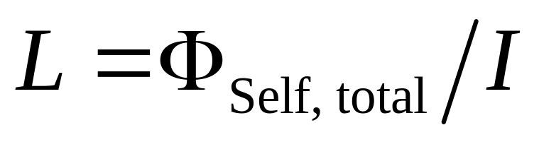
Group Problem: Solenoid
Calculate the self-inductance L of a solenoid (n turns per meter, length , radius R)
REMEMBER
Assume a current I is flowing in your device
Calculate the B field due to that I
Calculate the flux due to that B field
Calculate the self inductance (divide out I)
Notes:
Week 10, Day 1
Class 23

Slide 24
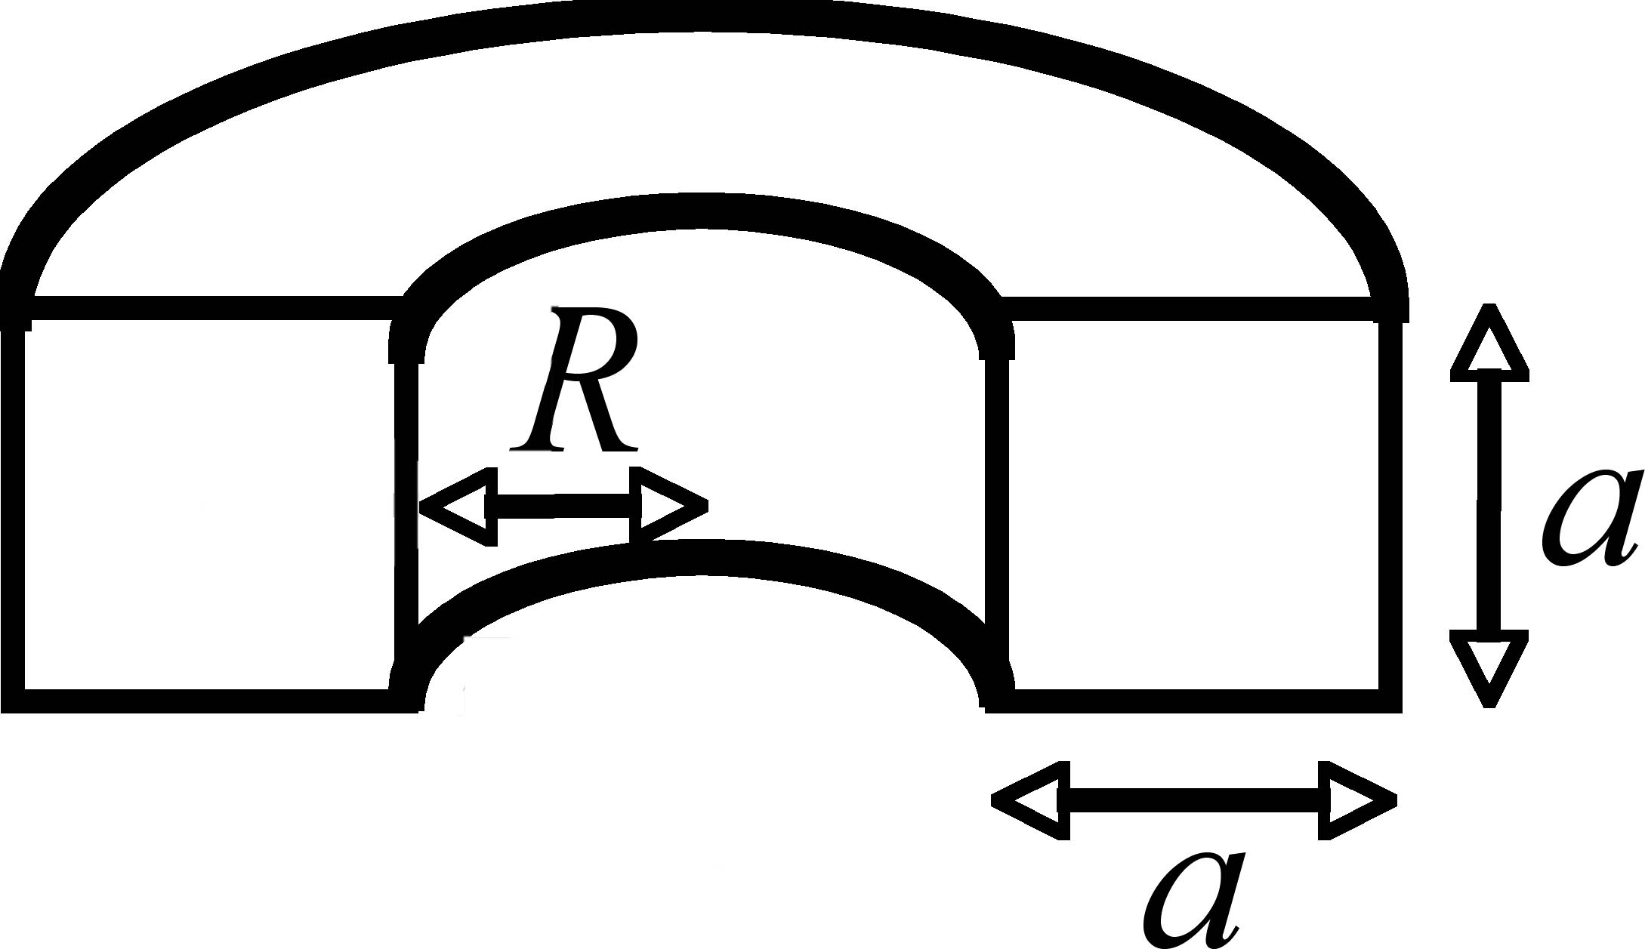
Group Problem: Torus
Calculate the inductance of the above torus (square cross-section of length a, radius R, N total turns)
1) For assumed current I, what is B(r)?
2) Calculate flux, divide out I
Notes:
Week 9, Day 3
Class 22

Slide 25
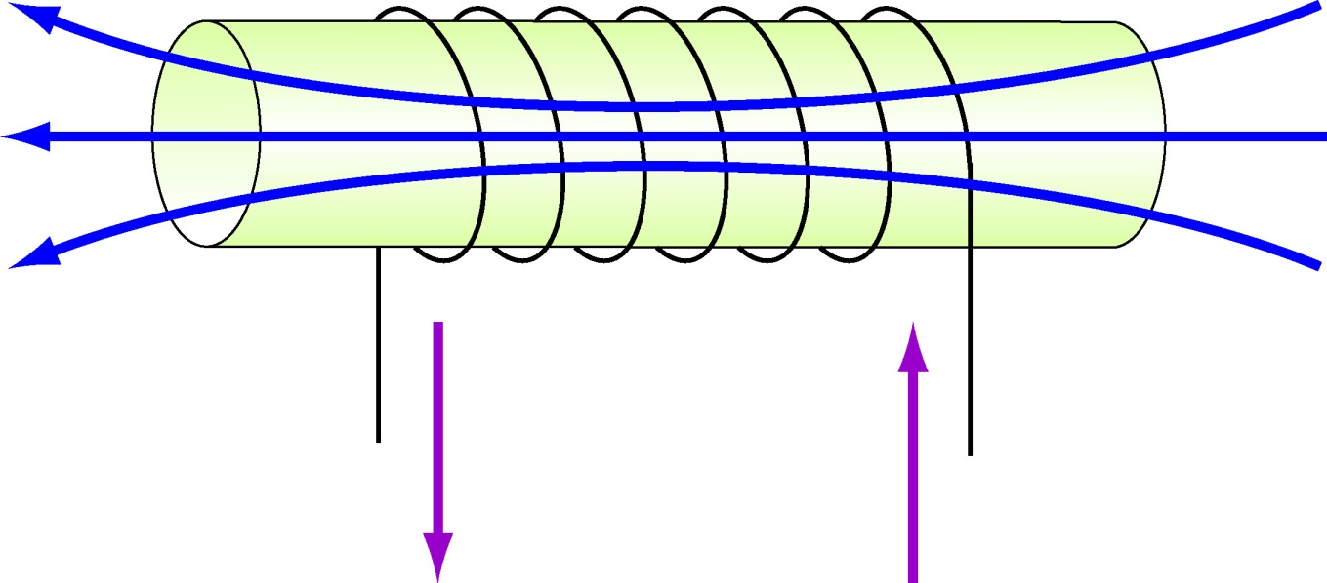
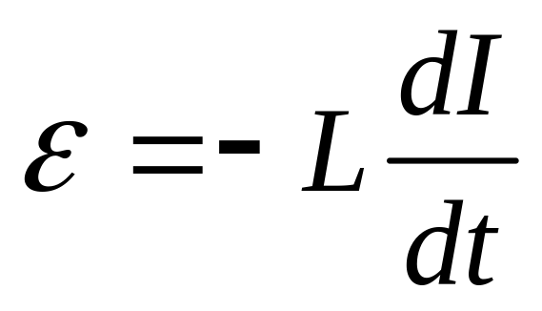
Review: Inductor Behavior
L
I
Inductor with constant current does nothing
Notes:
Week 9, Day 3
Class 22

Slide 26
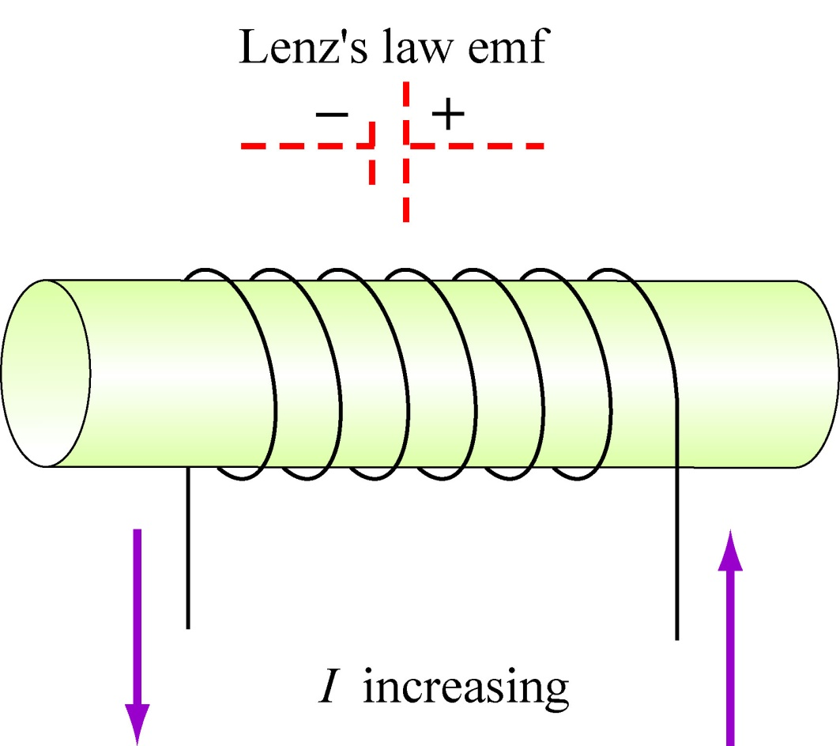
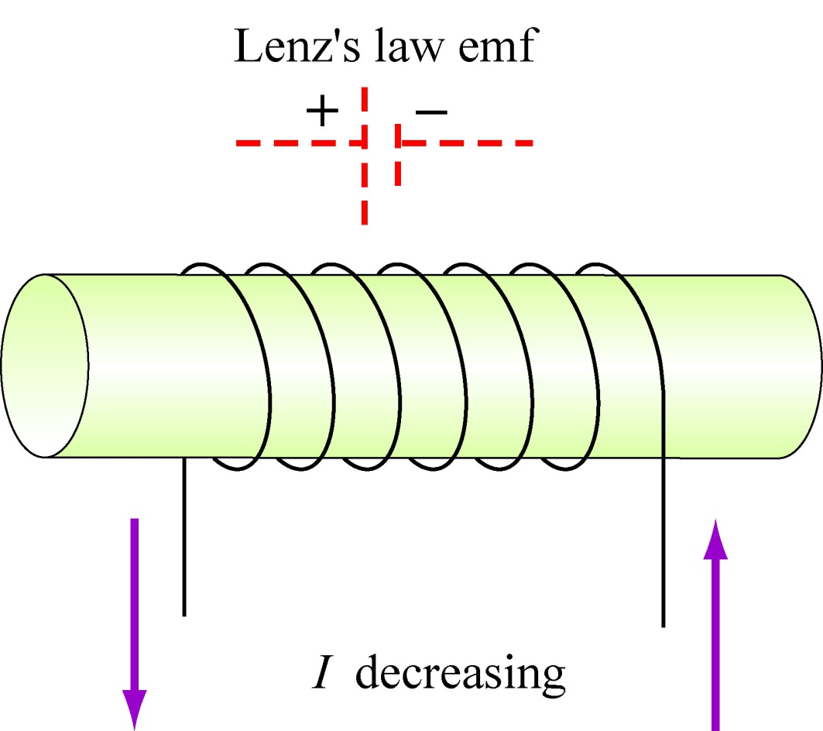
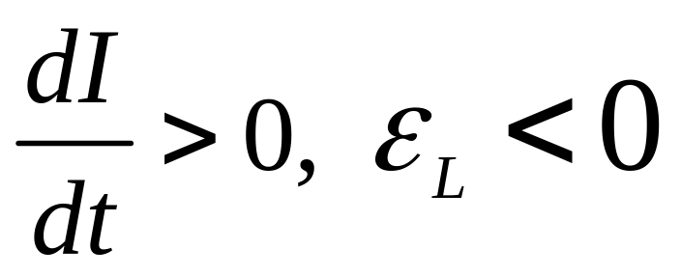
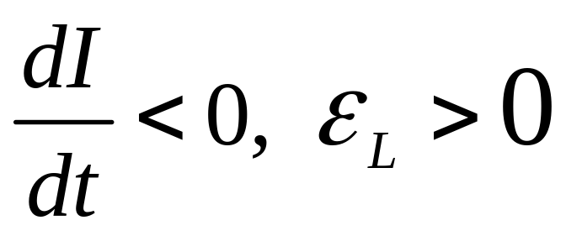
Back EMF
I
I
Notes:
Week 9, Day 3
Class 22

Slide 27
Demos: Breaking Circuits
Big Inductor
Marconi Coil
The Question:
What happens if big ΔI, small Δt
Notes:
Week 9, Day 3
Class 22

Slide 28
Inductor Behavior
L
I
Inductor with constant current does nothing
Notes:
Week 10, Day 1
Class 23

Slide 29
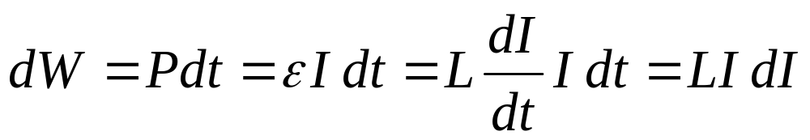
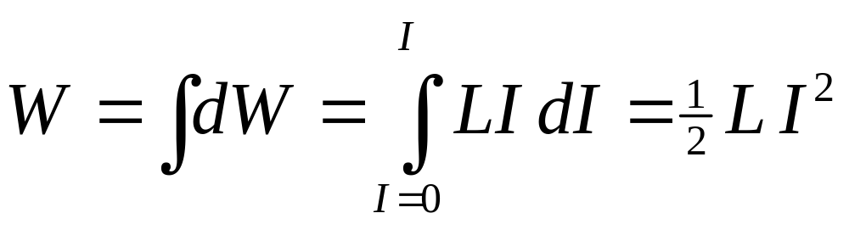
Energy To “Charge” Inductor
1. Start with “uncharged” inductor
2. Gradually increase current. Must work:
3. Integrate up to find total work done:
Notes:
Week 10, Day 1
Class 23

Slide 30
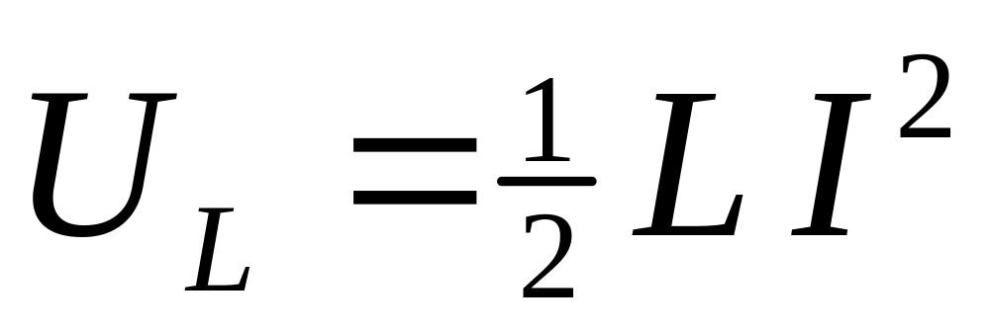
Energy Stored in Inductor
But where is energy stored?
Notes:
Week 10, Day 1
Class 23

Slide 31
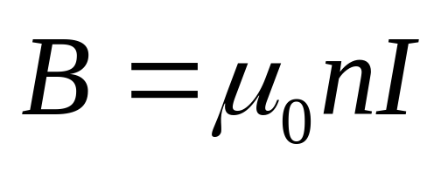
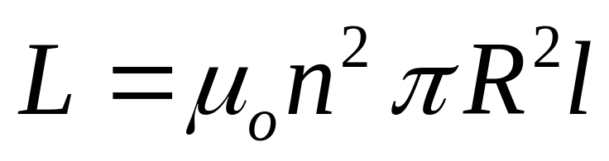
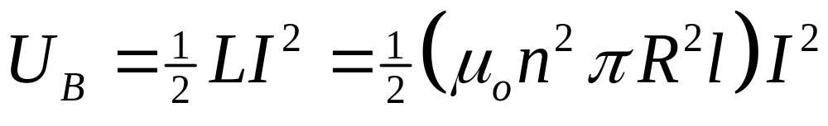
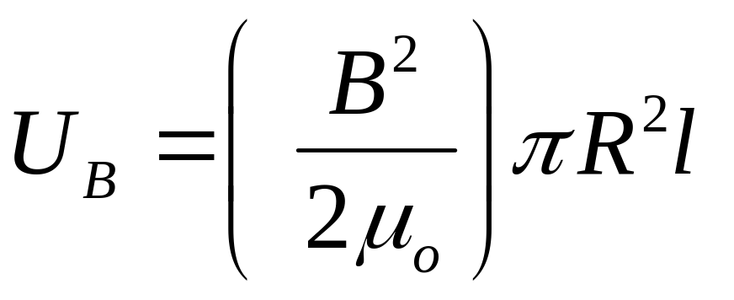
Example: Solenoid
Ideal solenoid, length l, radius R, n turns/length, current I:
Energy
Density
Volume
Notes:
Week 10, Day 1
Class 23

Slide 32
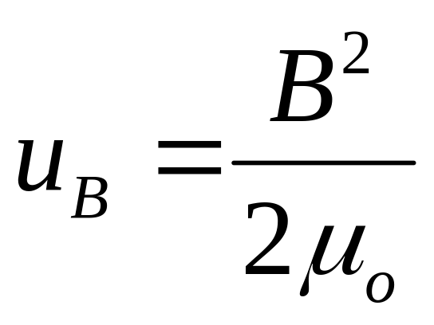
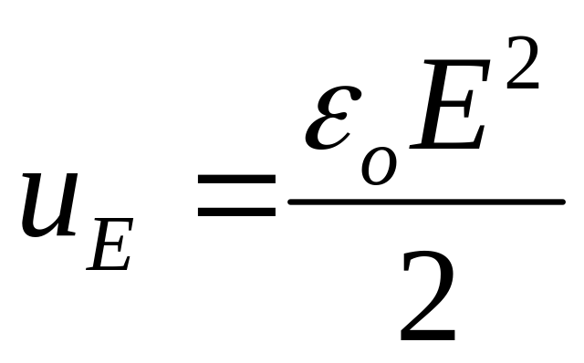
Energy Density
Energy is stored in the magnetic field!
: Magnetic Energy Density
: Electric Energy Density
Notes:
Week 10, Day 1
Class 23

